Slide 1
BOUND BROOK
SCHOOL DISTRICT
2025-2026
BUDGET PRESENTATION
Presented by:
Dr. Alvin L. Freeman, Superintendent of Schools
Ms. Robyn Griffin, Chief Academic Officer
Mr. Michael C. Gorski, CPA, Business Administrator/ Board Secretary
Ms. Kristine Lee, CPA, Assistant Business Administrator/Grants Mgr.

Slide 2
Members of the Board of Education
Mr. Richard Jannuzzi, Board President
Mr. Michael Bal, Board Vice President
Mr. Roger Zupko
Ms. Lisa Guzzino
Ms. Joanna Musson
Mr. Gagandeep Minhas
Mr. Sidney Dawson
Ms. Therese Sue High
Mr. Donald Vollmer
Mr. Nicholas Incalcaterra, South Bound Brook Representative
Student Board Representatives
Mr. Harrison Musson

Slide 3
Operations Committee
Mr. Roger Zupko, Chairperson
Mr. Richard Jannuzzi
Ms. Lisa Guzzino
Mr. Donald Vollmer
Mr. Nicholas Incalcaterra

Slide 4
Mission Statement
The Bound Brook Public Schools is a supportive multicultural community that provides an innovative and academically challenging educational program while offering a variety of extracurricular and social opportunities that encourage life-long learning and citizenship.

Slide 5
Vision Statement
Our vision is to provide a comprehensive educational program that will:
Promote citizenship through tolerance and diversity;
Prepare graduates for their educational and vocational choices in life;
Develop motivated, life-long learners;
Provide opportunities for students to be users of technology;
Encourage finders and users of data to develop problem solving skills;
Provide educational opportunities both within and outside the classroom;
Provide opportunities for the community to be a resource and learning center;
Challenge students educationally;
Provide a positive learning environment;
Recognize student successes; and
Promote academic and personal growth.

Slide 6
Board Goals
Board of Education Goals 2024 - 2025
Members of the Board of Education, Superintendent, and Business Administrator met
for an in-person NJSBA Workshop on August 21, 2024, to develop board of education
goals and board goals for the 2024-2025 school year.
Goal Setting
We reviewed the process of developing district and board of education goals. We had a
discussion regarding the goal-setting process with a focus on developing district and
board goals.
Following a robust discussion, the board came to a consensus on the following District
goals:
1. To provide the support and resources necessary to achieve the district’s
strategic plan goals
2. Support the exploration/expansion of new course offerings and extra-
curricular activities
3. Support the administration in recruiting and retaining a staff that reflects our
community
4. The Board of Education will strengthen communication with families and
community members by forming an ad hoc committee.

Slide 7
District Goals
District Goals 2024 - 2025:
1. To continue to create a safe environment where students and staff feel
comfortable taking risks and working collaboratively toward a common goal.
2. Fully utilize data through professional development to inform instruction and
strengthen student achievement.
3. Identify and celebrate contributions from staff, students and all stakeholders
in the achievement of district, BOE, and strategic goals.

Slide 8
Executive Summary
The Bound Brook School Budget for the 2025/2026 school year was developed within specific parameters set forth by the Board of Education:
To prepare a comprehensive budget, within revenue constraints:
  Meeting the needs of projected additional students.
  Allocate an increased amount of resources to Programs and Instruction.
  Expansion of curriculum programs and staffing to broadly improve student performance by New Jersey Student Learning Standards and Performance Data.
  Budget for Capital Outlay Projects required for health & safety.
  Budget for inflation especially in the areas of Transportation-contracted routes, Maintenance- contracted janitorial services, and Energy.
  To develop a budget that supports an educational program that meets the learning needs of ALL students while giving strong consideration to fiscal efficiency and the impact on the local taxpayer.
The budget has been professionally constructed to afford every student an opportunity for an exemplary education by well-trained, committed staff in a safe and secure environment. Opportunity is made available through a comprehensive curriculum which offers diverse course offerings and co-curricular clubs and activities. We believe that our proposed budget continues to become more efficient as evidenced by a successful County Budget Efficiency Review.

Slide 9
What Is The Budget Creation Timeline?
Establishment of Budget Philosophy
Enrollment Patterns and Projections
Review of Staffing Needs
Budget Development
Budget Defense Rounds
Governor’s Budget Address
Award of State Aid
Adoption of Tentative Budget
Public Hearing

Slide 10
Where Does The Money Come From ?

Slide 11
Dollars and Cents
Sources of Revenue
See handout A

Slide 12
General Fund Tax Levy
24/25 General Fund Tax Levy $13,965,571
25/26 Adjustment for Enrollment 1,552,491
25/26 Adjusted General Fund Tax Levy 15,828,423
25/26 Adjustment for Healthcare 551,555
25/26 Tax Levy Cap (Maximum) 16,379,978
25/26 Tax Levy Proposed 14,244,882
Increase in 25/26 vs 24/25 General Fund Levy $279,311
Notes: (1) No prior years banked cap has been appropriated.
(2) The optional Health care cap adjustment, and enrollment adjustment to cap, would have increased cap, and taxes, but it has not been applied to the levy. It will instead carry-over as banked cap.

Slide 13
Key Facts On State Aid
There are two types of State Aid:
Equalization Aid- Distributed by property wealth and income levels Bound Brook has been awarded $33,438,223 in this category.
Categorical Aid- Awarded by number of students who qualify for each individual aid category. Bound Brook qualifies for a few categories. but is limited in award due to over adequacy status.
General Fund State Aid is 60% of our total revenue to support the school budget.

Slide 14
General Fund State Aid
2024/2025 2025/2026
Equalization Aid $31,381,837 $33,438,223
Categorical Aid:
Special Education Aid 2,241,787 2,511,744
Security Aid 1,049,044 830,194
Transportation Aid 155,401 137,591
Preschool Education Aid 2,050,796 1,768,877
School Choice Aid 126,344 131,835
Debt Service Aid 886,788 870,480
SDA Assessment for funding (9,836) (9,836)
Total $37,882,161 $39,679,108
Increase in General Fund State Aid +$1,796,947
Percent increase vs. last year +4.7%

Slide 15
Where Does The Money Go?

Slide 16
Appropriations Detail
See handout B

Slide 17
Budget Appropriations Considerations
Budgets are driven by student enrollment
Enrollment Data from ASSA.

Slide 18
What Programs Are In This Budget?
Curriculum and Instruction
For the 2025-26 school year, our focus will be on enhancing curriculum and programs across all levels.
Enhancing curriculum and programs for the 2025-26 school year.
Procuring new and updated materials for History and Math courses at the middle school level.
Ensuring alignment of curriculum maps with the latest ELA and Math standards.
Expanding updates to include ELA (grades K-8), ESL (grades K-12), French (grades 9-12), Spanish (grades 7-12), and high school courses in Science, Math, Social Studies, and ELA.
Hiring new bilingual Math and Special Education teachers to provide additional support for our students.
Enhancing summer and before/after-school enrichment opportunities for all students.
Expanding special programs for students and families, such as Parent Math/ELA Nights, Global Day of Play, and Author’s Breakfasts.

Slide 19
What Programs Are In This Budget?
Curriculum and Instruction :
Additional Staff (7)
Bilingual Math Teacher
3 High School Teachers (Math, Science, Social Studies)
2 Special Education Teachers
Assistant Superintendent
Textbooks/Programs/Resources
ELA expansion of core text, novels, mentor texts, and classroom libraries: K-12
Document cameras for classrooms: 1-2
Science Kits and Materials: 6
MS Social Studies: 7-8
MS Math: 7-8
MS/HS Social Studies: DBQ Project 7-12
World Language Textbooks

Slide 20
What Programs Are In This Budget?
Curriculum Rewriting, Revisions, Updates:
Elementary
ELA K-2 Writing Programs
ESL K-1
Math/Science 2-3
Science 6
Spanish 4-6
Middle
ESL Level I, II, III
Integrated Language Arts
Spanish I, II
ELA 7-8
Social Studies 7-8
High School
AP Chemistry
Special Education Math
Math 9-12
ESL IV Integrated Language Arts
Spanish I, II, III Honors, IV Honors, Spanish Heritage Language I, II, Ap Spanish Language and Culture
French I, II, III Honors, IV Honors
English Folklore, Film
English I, II, III, IV
US History I, II, World History

Slide 21
What Programs Are In This Budget?
Curriculum and Instruction
Maintaining 2020 New Jersey Student Learning Standards
Maintaining Curriculum Writing and Mapping
Multi-tiered Systems of Support
In-School, Before- & After-School, and Summer Support for Students
Textbook Replacement/Adoptions
Technology Replacement/Additional Online Programs
Gifted and Talented Opportunities
Multilingual Learners Supports
Assessment to Guide Instruction
LinkIt Data Warehouse and Benchmarks
DRA3
Dibels
Key 3 Math
IXL
iReady
Professional Development
Professional Memberships

Slide 22
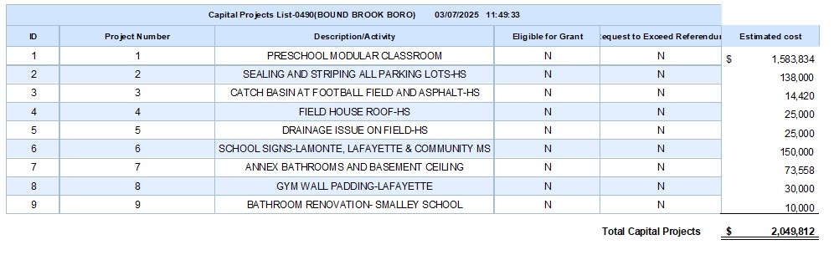
What Is Included In This Budget
Capital Projects

Slide 23
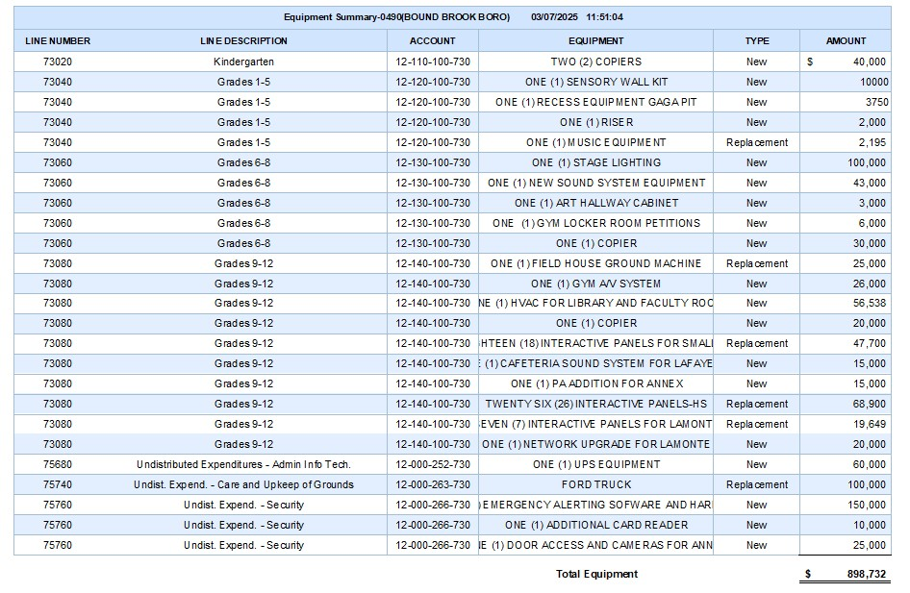
What Is Included In This Budget
Equipment

Slide 24
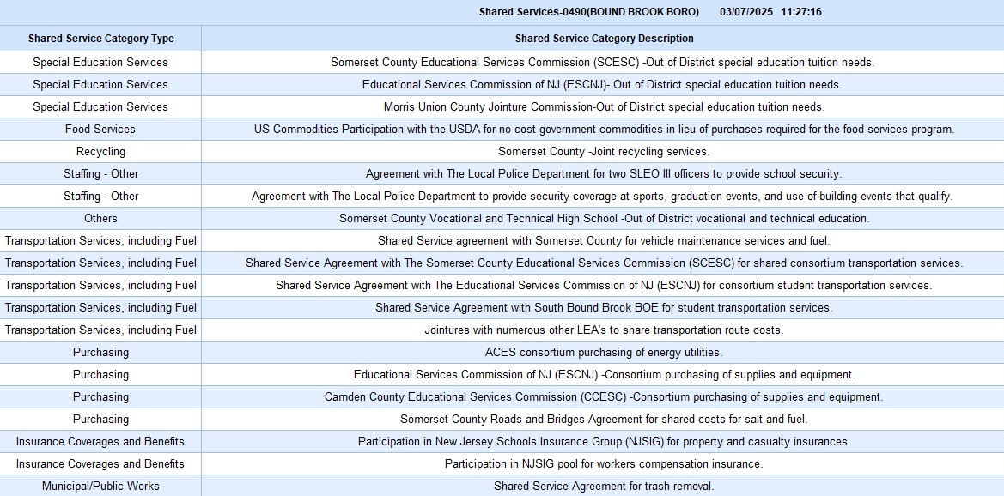
Cost Savings From Shared Services

Slide 25
What factors influence the tax rate?
State Aid
Fund Balance Applied
Ratables
Increased Student Enrollment effect on Appropriations

Slide 26
School District
Average Assessed Tax Levy Impact
2024/2025 School Tax Rate 1.165%
2025/2026 School Tax Rate 1.117%
Decrease in 2025/2026 School Tax Rate – 3.9cents
The average assessed home of $447,665 will experience a 2025/2026 School Tax decreased of approximately $170

Slide 27

Thank You To All Who Contributed
To Developing This Budget

